Slide 1
Lecture 2
VLSI Test Process and Equipment
Motivation
Types of Testing
Test Specifications and Plan
Test Programming
Test Data Analysis
Automatic Test Equipment
Parametric Testing
Summary

Slide 2
Motivation
Need to understand Automatic Test Equipment (ATE) technology
  Influences what tests are possible
  Serious analog measurement limitations at high digital frequency or in the analog domain
  Understand capabilities for digital logic, memory, and analog test for testing System-on-a-Chip (SOC)
Need to understand parametric testing
  For setup and hold time measurements
  For determination of V_{IL} , V_{IH} , V_{OL} , V_{OH} , t_{r} , t_{f} , t_{d} , I_{OL}, I_{OH} , I_{IL}, I_{IH}

Slide 3
Types of Testing
Verification testing, characterization testing, or design debug
  Verifies correctness of design and correctness of test procedure – may require correction of either or both
Manufacturing testing
  Factory testing of all manufactured chips for parametric and logic faults, and analog specifications
  Burn-in or stress testing
Acceptance testing (incoming inspection)
  User (customer) tests purchased parts to ensure quality

Slide 4
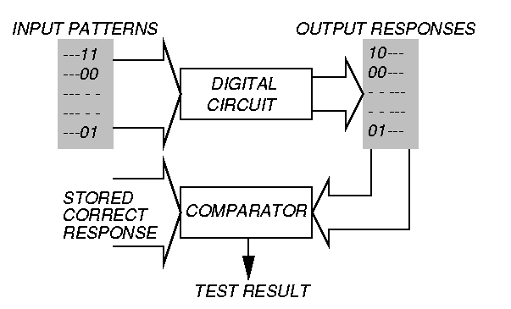
Testing Principle

Slide 5
Automatic Test Equipment (ATE)
Consists of:
  Powerful computer
  Powerful 32-bit Digital Signal Processor (DSP) for analog testing
  Test Program (written in high-level language) running on the computer
  Probe Head (actually touches the bare or packaged chip to perform fault detection experiments)
  Probe Card or Membrane Probe (contains electronics to measure signals on chip pin or pad)

Slide 6
Characterization or Verification Test
Ferociously expensive
  Applied to selected (not all) parts
  Used prior to production or manufacturing test
May comprise:
  Scanning Electron Microscope tests
  Bright-Lite detection of defects
  Electron beam testing
  Artificial intelligence (expert system) methods
  Repeated functional tests

Slide 7
Characterization (Cont.)
Worst-case test
  Choose test that passes/fails chips
  Select statistically significant sample of chips
  Repeat test for every combination of environmental variables
  Plot results in Shmoo plot
  Diagnose and correct design errors
Continue throughout production life of chips to improve design and process to increase yield

Slide 8
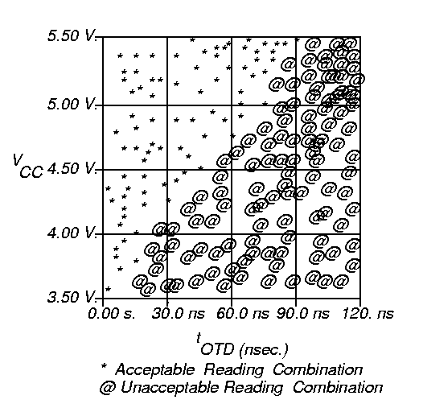
Shmoo Plot
CS
t_{OTD}
DATA
SRAM read operation:
t_{OTD} = time to DATA
tristated after
chip deselect

Slide 9
Manufacturing Test
Determines whether manufactured chip meets specification
Must cover high % of modeled faults
Must minimize test time (to control cost)
No fault diagnosis
Test every device on chip
Test at rated speed or at maximum speed guaranteed by supplier

Slide 10
Burn-in or Stress Test
Process:
  Subject chips to high temperature and over-voltage supply, while running production tests
Catches:
  Infant mortality cases – these are damaged or weak (low reliability) chips that will fail in the first few days of operation – burn-in causes bad devices to fail before they are shipped to customers
  Freak failures – devices having same failure mechanisms as reliable devices

Slide 11
Incoming Inspection
Can be:
  Similar to production testing
  More comprehensive than production testing
  Tuned to specific system application
Often done for a random sample of devices
  Sample size depends on device quality and system reliability requirements
  Avoids putting defective device in a system where cost of diagnosis and repair exceeds incoming inspection cost

Slide 12
Manufacturing Test Scenarios
Wafer sort or probe test – done before wafer is scribed and cut into chips
  Includes test site characterization – specific test devices are checked with specific patterns to measure:
    Gate threshold
    Polysilicon field threshold
    Poly sheet resistance, etc.
Packaged device tests

Slide 13
Types of Tests
Parametric – measures electrical properties of pin electronics – delay, voltages, currents, etc. – fast and cheap
Functional – used to cover very high % of modeled faults – test every transistor and wire in digital circuits – long and expensive – main topic of tutorial

Slide 14
Two Different Meanings of Functional Test
ATE and Manufacturing World – any vectors applied to cover high % of faults during manufacturing test
Automatic Test-Pattern Generation World – testing with verification vectors, which determine whether hardware matches its specification – typically have low fault coverage (< 70 %)

Slide 15
Test Specifications & Plan
Test Specifications:
  Functional Characteristics
  Type of Device Under Test (DUT)
  Physical Constraints – package, pin numbers, etc.
  Environmental Characteristics – power supply, temperature, humidity, etc.
  Reliability – acceptance quality level (defects/million), failure rate, etc.
Test plan generated from specifications
  Type of test equipment to use
  Types of tests
  Fault coverage requirement

Slide 16
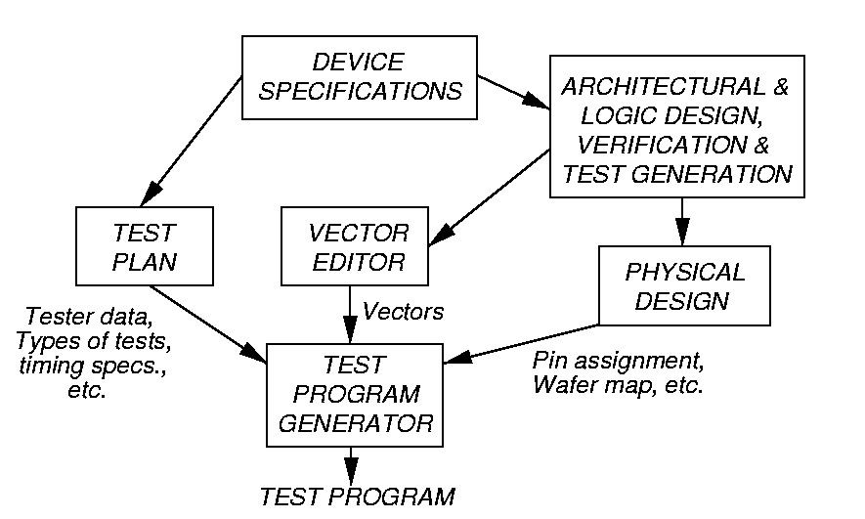
Test Programming

Slide 17
Test Data Analysis
Uses of ATE test data:
  Reject bad DUTs
  Fabrication process information
  Design weakness information
Devices that did not fail are good only if tests covered 100% of faults
Failure mode analysis (FMA):
  Diagnose reasons for device failure, and find design and process weaknesses
  Improve logic and layout design rules

Slide 18
Automatic Test Equipment (ATE)

Slide 19
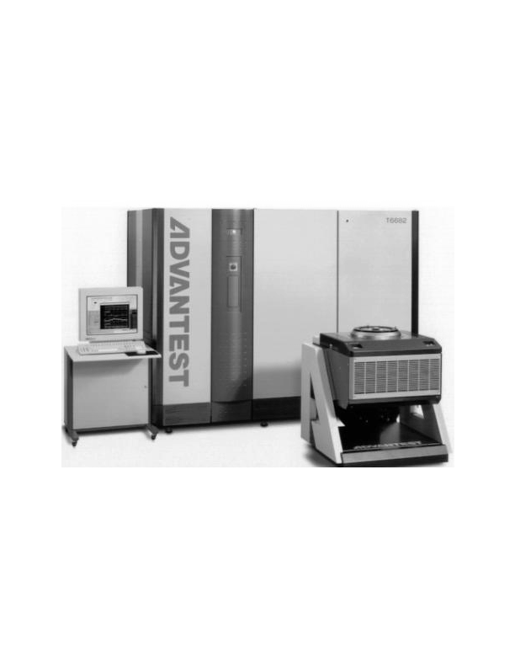
ADVANTEST Model T6682 ATE

Slide 20
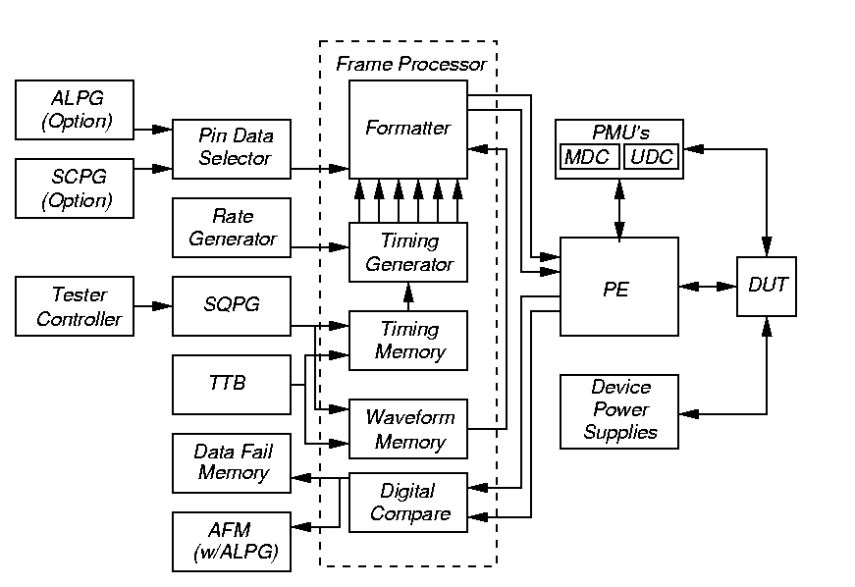
T6682 ATE Block Diagram

Slide 21
T6682 ATE Specifications
Uses 0.35μ VLSI chips in implementation
1,024 digital pin channels
Speed: 250, 500, or 1000 MHz
Timing accuracy: +/- 200 ps
Drive voltage: - 2.5 to 6 V
Clock/strobe accuracy: +/- 870 ps
Clock settling resolution: 31.25 ps
Pattern multiplexing: write 2 patterns in one ATE cycle
Pin multiplexing: use 2 pins to control 1 DUT pin

Slide 22
Pattern Generation
Sequential pattern generator (SQPG): stores 16 Mvectors of patterns to apply to DUT -- vector width determined by # DUT pins
Algorithmic pattern generator (ALPG): 32 independent address bits, 36 data bits
  For memory test – has address descrambler
  Has address failure memory
Scan pattern generator (SCPG) supports JTAG boundary scan, greatly reduces test vector memory for full-scan testing
  2 Gvector or 8 Gvector sizes

Slide 23
Response Checking and Frame Processor
Response Checking:
  Pulse train matching – ATE matches patterns on 1 pin for up to 16 cycles
  Pattern matching mode – matches pattern on a number of pins in 1 cycle
  Determines whether DUT output is correct, changes patterns in real time
Frame Processor – combines DUT input stimulus from pattern generators with DUT output waveform comparison
Strobe time – interval after pattern application when outputs sampled

Slide 24
Probing
Pin electronics (PE) – electrical buffering circuits, put as close as possible to DUT
Uses pogo pin connector at test head
Test head interface through custom printed circuit board to wafer prober (unpackaged chip test) or package handler (packaged chip test), touches chips through a socket (contactor)
Uses liquid cooling
Can independently set V_{IH} , V_{IL} , V_{OH} , V_{OL}, I_{H} , I_{L}, V_{T} for each pin
Parametric Measurement Unit (PMU)

Slide 25
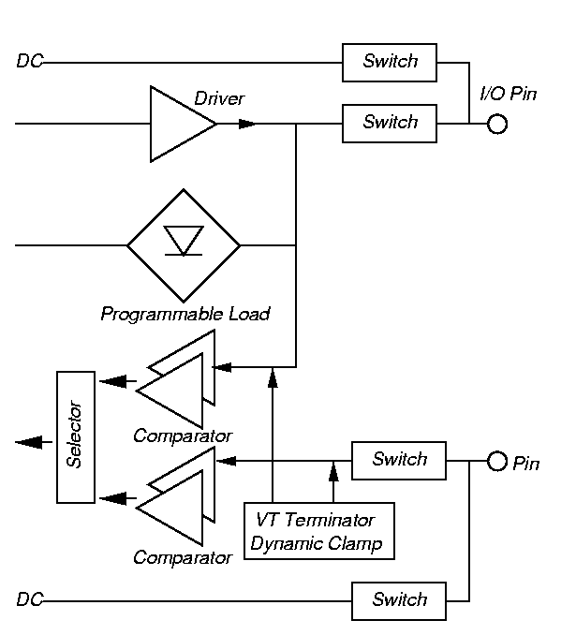
Pin Electronics

Slide 26
Probe Card and Probe Needles or Membrane
Probe card – custom printed circuit board (PCB) on which DUT is mounted in socket – may contain custom measurement hardware (current test)
Probe needles – come down and scratch the pads to stimulate/read pins
Membrane probe – for unpackaged wafers – contacts printed on flexible membrane, pulled down onto wafer with compressed air to get wiping action

Slide 27
T6682 ATE Software
Runs Solaris UNIX on UltraSPARC 167 MHz CPU for non-real time functions
Runs real-time OS on UltraSPARC 200 MHz CPU for tester control
Peripherals: disk, CD-ROM, micro-floppy, monitor, keyboard, HP GPIB, Ethernet
Viewpoint software provided to debug, evaluate, and analyze VLSI chips

Slide 28
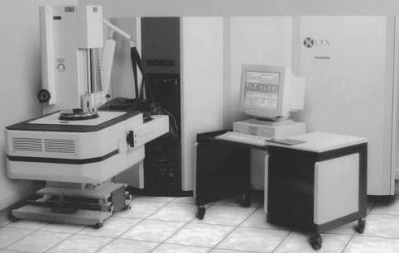
LTX FUSION HF ATE

Slide 29
Specifications
Intended for SOC test – digital, analog, and memory test – supports scan-based test
Modular – can be upgraded with additional instruments as test requirements change
enVision Operating System
1 or 2 test heads per tester, maximum of 1024 digital pins, 1 GHz maximum test rate
Maximum 64 Mvectors memory storage
Analog instruments: DSP-based synthesizers, digitizers, time measurement, power test, Radio Frequency (RF) source and measurement capability (4.3 GHz)

Slide 30
Multi-site Testing – Major Cost Reduction
One ATE tests several (usually identical) devices at the same time
For both probe and package test
DUT interface board has > 1 sockets
Add more instruments to ATE to handle multiple devices simultaneously
Usually test 2 or 4 DUTS at a time, usually test 32 or 64 memory chips at a time
Limits: # instruments available in ATE, type of handling equipment available for package

Slide 31
Electrical Parametric Testing

Slide 32
Typical Test Program
Probe test (wafer sort) – catches gross defects
Contact electrical test
Functional & layout-related test
DC parametric test
AC parametric test
  Unacceptable voltage/current/delay at pin
  Unacceptable device operation limits

Slide 33
DC Parametric Tests

Slide 34
Contact Test
Set all inputs to 0 V
Force current I_{fb} out of pin (expect I_{fb} to be 100 to 250 mA)
Measure pin voltage V_{pin}. Calculate pin resistance R
  Contact short (R = 0 W)
  No problem
  Pin open circuited (R huge), I_{fb} and V_{pin} large

Slide 35
Power Consumption Test
Set temperature to worst case, open circuit DUT outputs
Measure maximum device current drawn from supply I_{CC} at specified voltage
  I_{CC} > 70 mA (fails)
  40 mA < I_{CC} ≤ 70 mA (ok)

Slide 36
Output Short Current Test
Make chip output a 1
Short output pin to 0 V in PMU
Measure short current (but not for long, or the pin driver burns out)
  Short current > 40 μA (ok)
  Short current ≤ 40 μA (fails)

Slide 37
Output Drive Current Test
Apply vector forcing pin to 0
Simultaneously force V_{OL} voltage and measure I_{OL}
Repeat Step 2 for logic 1
  I_{OL} < 2.1 mA (fails)
  I_{OH} < -1 mA (fails)

Slide 38
Threshold Test
For each I/P pin, write logic 0 followed by propagation pattern to output. Read output. Increase input voltage in 0.1 V steps until output value is wrong
Repeat process, but stepping down from logic 1 by 0.1 V until output value fails
  Wrong output when 0 input > 0.8 V (ok)
  Wrong output when 0 input ≤ 0.8 V (fails)
  Wrong output when 1 input < 2.0 V (ok)
  Wrong output when 1 input ≥ 2.0 V (fails)

Slide 39
AC Parametric Tests

Slide 40
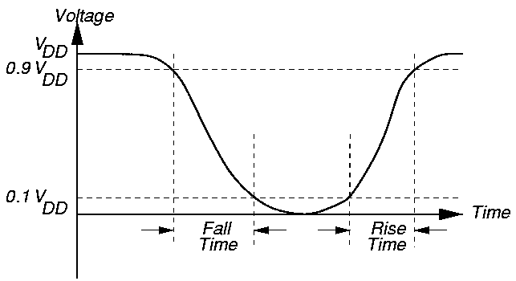
Rise/fall Time Tests

Slide 41
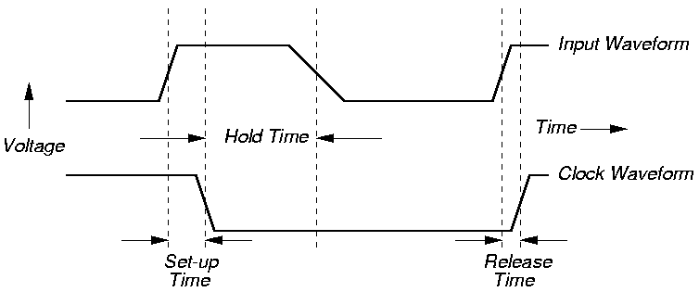
Set-up and Hold Time Tests

Slide 42
Propagation Delay Tests
Apply standard output pin load (RC or RL)
Apply input pulse with specific rise/fall
Measure propagation delay from input to output
  Delay between 5 ns and 40 ns (ok)
  Delay outside range (fails)

Slide 43
Summary
Parametric tests – determine whether pin electronics system meets digital logic voltage, current, and delay time specs
Functional tests – determine whether internal logic/analog sub-systems behave correctly
ATE Cost Problems
  Pin inductance (expensive probing)
  Multi-GHz frequencies
  High pin count (1024)
ATE Cost Reduction
  Multi-Site Testing
  DFT methods like Built-In Self-Test

